Slide 1
Fall Detection
Group 4

Slide 2



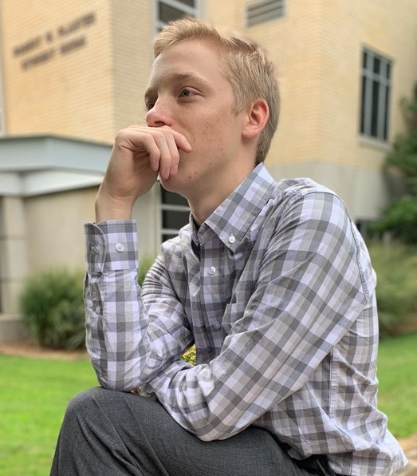
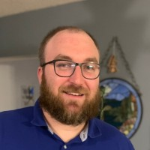
Gavin Burris Logan Kilfoy Logan Koch
Mason Sanborn Kyle Lepine
gbb123@live.missouristate.edu
kilfoy0216@live.missouristate.edu
koch170@live.missouristate.edu
sanborn99@live.missouristate.edu
kml2008@live.missouristate.edu
Notes:
sanborn99@live.missouristate.edu
koch170@live.missouristate.edu
kilfoy0216@live.missouristate.edu
lepine2008@live.missouristate.edu
gbb123@live.missouristate.edu

Slide 3
Project Motivation
We want to help accelerate response time to fall-related incidents by creating software that can determine falls in real-time. We hope to achieve accurate and speedy detections to help prevent dangerous falls from turning into life-threatening altercations as the victims are rendered unable to call for help.

Slide 4
Project Goals
Going into this project we had a basic outline of what was required by our stakeholder Snigdha, but we also had some of our own personal goals. We knew we wanted to be able to detect people by means of a camera, and then detect what kind of state they are in using a set of templates based on our own bodies. These templates are the driving idea behind our program and we are able to detect falls by comparing them to a subject in the current frame.
Our other goals mostly consist of being able to detect falls in different situations. Things like different lighting, close up and far distance, and partially obstructed situations required us to change our approach as we continued working.

Slide 5

Project Development
Total Estimated Task Hours: 202.5 Hours
Total User Story Hours: 263.5 Hours
(Completed Tasks)
Meeting Frequency: 3 - 4 per week
Software Approach: Agile Approach
https://unsplash.com/photos/SYTO3xs06fU
Notes:
Total Estimated Hours: S1 (64), S2 (102), S3 (102), S4 (92 hours), S5 (70)
Total Actual Hours: S1 (44), S2 (87.5), S3 (72 hours), S4 (18 hours), S5 (42 hours)

Slide 6

System Functionalities
Detect people that walk within the frame.
Classify the position the people are in using templates.
Detect when a person falls over using templates.
Throw a flag when a fall has been detected.
Detect falls within 0 - 25 feet of the system’s camera.
Detect falls with an obstructed view on the subject.
Detect falls in changing lightning conditions.
Fall Detected

Slide 7
Project Pitfalls
During the research and development (R&D) of the project, it was hard to consistently work on the code base with other assignments taking priority. As soon as we would get in a “groove”, we were interrupted with an assignment or other work with higher priority.
During the R&D of the project, we as a team set unrealistic targets and/or deadlines for features in our project. This led to poor time and priority decisions, which ultimately slowed down certain features from being included in the final project.
At the beginning, we struggled with determining how we wanted to go about detecting people in frame. This was the biggest hurdle we had and we ended up putting a significant amount of time towards US:03 as a result.

Slide 8

System Software
Technologies
OpenCV : OpenCV (Open Source Computer Vision Library) is an open source computer vision and machine learning software library. https://opencv.org/
Psycopg2 : Psycopg is the most popular PostgreSQL database adapter for the Python programming language. https://www.psycopg.org/

Slide 9
System Software (cont.)
Technologies
Numpy : library that provides a large collection of high-level mathematical functions to operate on multi-dimensional arrays and matrices. https://numpy.org/
Imutils : A series of convenience functions to make basic image processing functions such as translation, rotation, resizing, skeletonization, displaying Matplotlib images, sorting contours, detecting edges, and much more easier with OpenCV and both Python 2.7 and Python 3. https://github.com/jrosebr1/imutils

Slide 10
System Software (cont.)
Technologies
Postgres : An open source object-relational database system with over 30 years of active development that has earned it a strong reputation for reliability, feature robustness, and performance. https://www.postgresql.org/

Slide 11

Project Links
https://github.com/kylelepine/CSC450-Project-4

